Slide 1
MD5
Message digest version 5

Slide 2
What is MD5?
Hashing algorithm.
Designed by Ronald Rivest.
Designed in 1991.
What is Hashing?
Converts plain text to hash digest.
Generate unique string.
Why Hashing?
Security.

Slide 3
How MD5 works
Input.
Process input.
Generating the message digest.

Slide 4
Input
Message
Initial digest
(Constants)
512 bits
512 bits
512 bits
MD Transformation
MD Transformation
MD Transformation
Final message digest

Slide 5
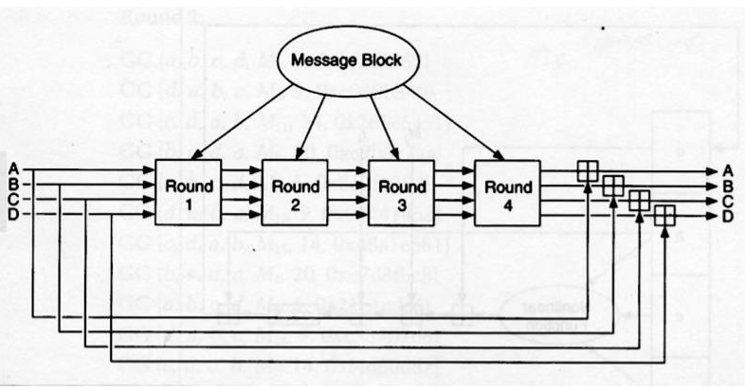
Input processing

Slide 6
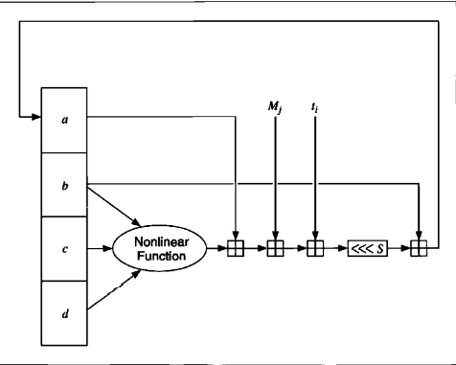
Message digest generation

Slide 7
Non-linear functions
F(x, y, z) = (x ^ y) ∨ ((¬x) ∨ z) G(x, y, z) = (x ^ y) ∨ (y ∨ (¬z)) H(x, y, z) = x ⊕ y ⊕ z I(x, y, z) = y ⊕ (x ∨ (¬z))
FF(a, b, c, d, M_{i}, s, t_{i}) denotes a = b + ((a + F(b, c, d) + M_{i} + t_{i}) <<< s) GG(a, b, c, d, M_{i}, s, t_{i}) denotes a = b + ((a + G(b, c, d) + M_{i} + t_{i}) <<< s) HH(a, b, c, d, M_{i}, s, t_{i}) denotes a = b + ((a + H(b, c, d) + M_{i} + t_{i}) <<< s) II(a, b, c, d, M_{i}, s, t_{i}) denotes a = b + ((a + I(b, c, d) + M_{i} + t_{i}) <<< s)

